Slide 1







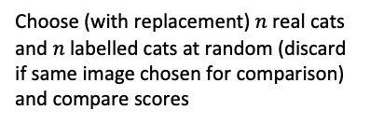



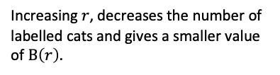



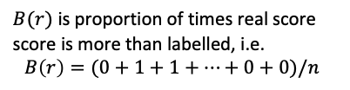
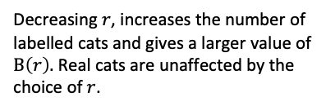
(a) Scored data set
87
85
82
79
74
73
68
66
61
39
28
12
(b) How $B\left(r\right)$ is calculated
Real cats
85
Choose (with replacement) $n$real cats and $n$ labelled cats at random (discard if same image chosen for comparison) and compare scores
87
82
79
68
66
68
87
79
$$…$$
85
79
>
1
>
1
>
0
0
Labelled cats (r=67)
>
0
>
87
85
82
73
68
73
87
82
$B(r)$ is proportion of times real score score is more than labelled, i.e.
$$B\left(r\right)=(0+1+1+…+0+0)/n$$
79
74
73
68
In this example: $B(67)≈0.49$ and $C\left(67\right)=5/7≈\text{0.}\text{71}$
(c) Effect of changing threshold ($r$)
Labelled cats (r=60)
Decreasing $r$, increases the number of labelled cats and gives a larger value of
$B\left(r\right).$ Real cats are unaffected by the choice of $r$.
87
85
82
79
74
73
68
66
61
In this example: $B(60)≈$0.60 and $C\left(60\right)=6/9≈\text{0.6}\text{6}$
Labelled cats (r=75)
Increasing $r$, decreases the number of labelled cats and gives a smaller value of $B\left(r\right).$
87
85
82
79
In this example: $B\left(75\right)≈0.49$ and $C\left(75\right)=4/4=1$

